Slide 1
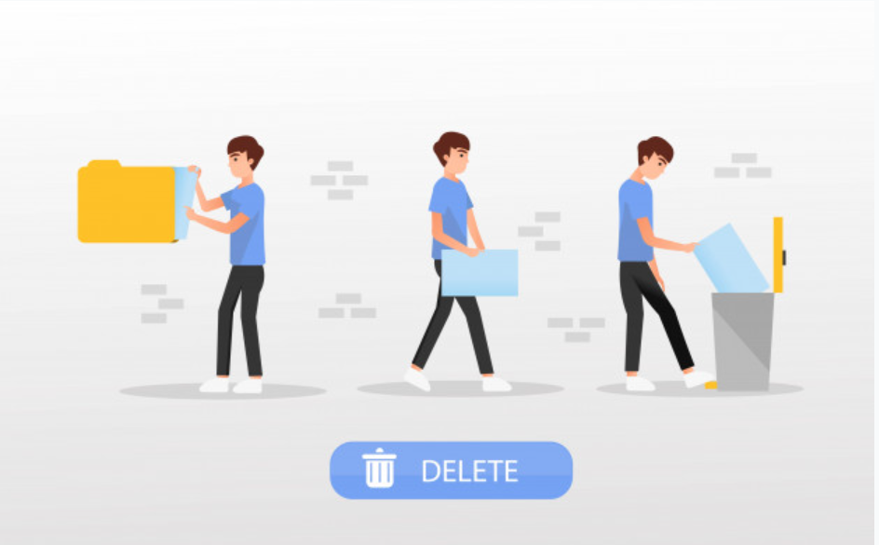
Delete Text File
Text File Automation with Commands
Lecture-11

